Slide 1



ONLINE WORKSHOP
POWER BOUNCE
WELCOME!

Slide 2
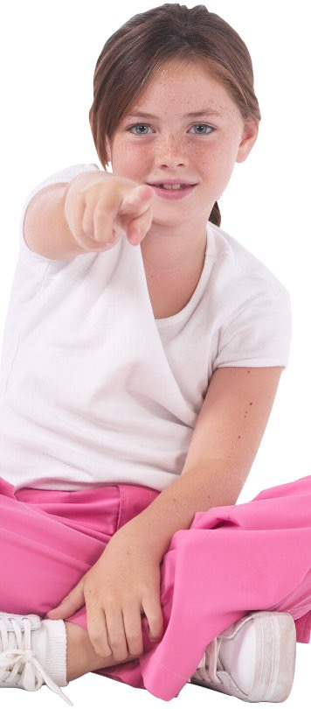


POWER BOUNCE
GAME: WOULD YOU RATHER?

Slide 3
POWER BOUNCE
GAME: WOULD YOU RATHER?
Summer
or
Winter?

Slide 4
POWER BOUNCE
GAME: WOULD YOU RATHER?
Chocolate
or Vanilla
Ice Cream?

Slide 5
POWER BOUNCE
GAME: WOULD YOU RATHER?
Cats
or
Dogs?

Slide 6
POWER BOUNCE
GAME: WOULD YOU RATHER?
Sweet
or
Savoury?

Slide 7
POWER BOUNCE
GAME: WOULD YOU RATHER?
Peas
or
Carrots?

Slide 8
POWER BOUNCE
GAME: WOULD YOU RATHER?
Sing
or
Dance?

Slide 9
POWER BOUNCE
GAME: WOULD YOU RATHER?
Purple
or
Green?

Slide 10
POWER BOUNCE
GAME: WOULD YOU RATHER?
Christmas
or
Birthday?

Slide 11
POWER BOUNCE
GAME: WOULD YOU RATHER?
Books
or
Movies?

Slide 12
POWER BOUNCE
GAME: WOULD YOU RATHER?
School
or
Holidays?

Slide 13
POWER BOUNCE
GAME: WOULD YOU RATHER?
Apples
or
Bananas?

Slide 14
POWER BOUNCE
GAME: WOULD YOU RATHER?
Drawing
or
Kicking a Ball?

Slide 15
POWER BOUNCE
GAME: WOULD YOU RATHER?
Dresses
or
Jeans?

Slide 16
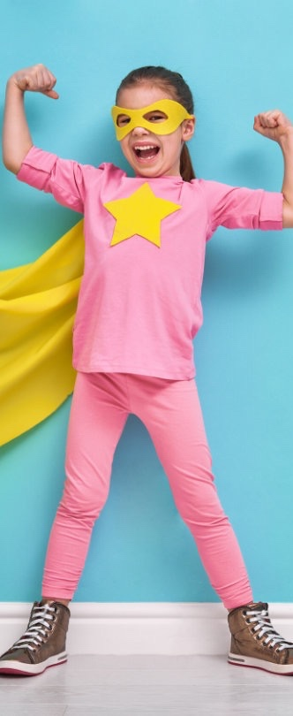
POWER BOUNCE
GROWTH vs FIXED
MINDSET

Slide 17

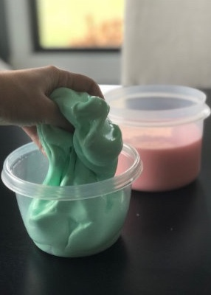
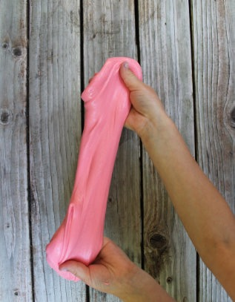
POWER BOUNCE
LOOK AT THIS
SLIME
CAN IT
STRETCH?
YES!

Slide 18
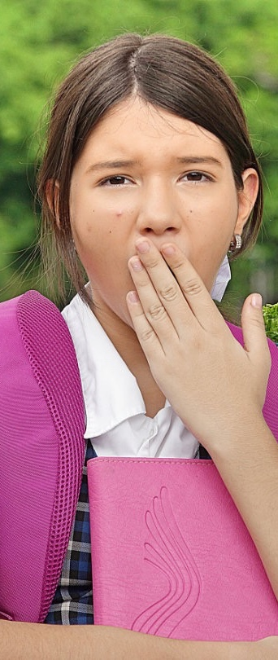
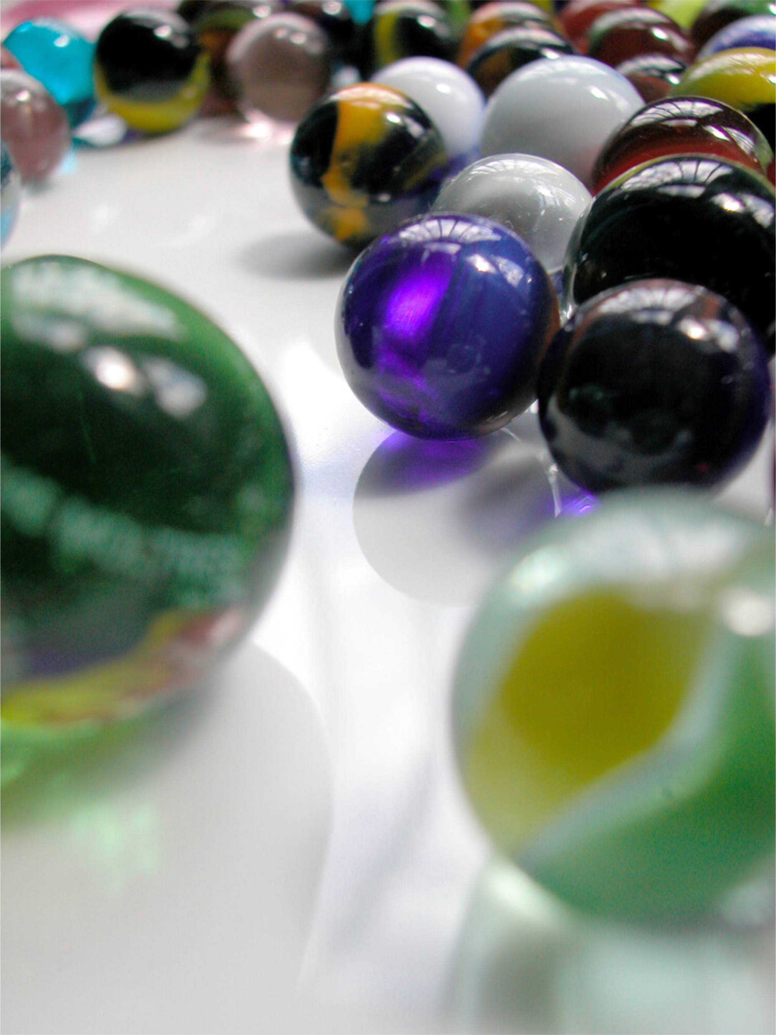
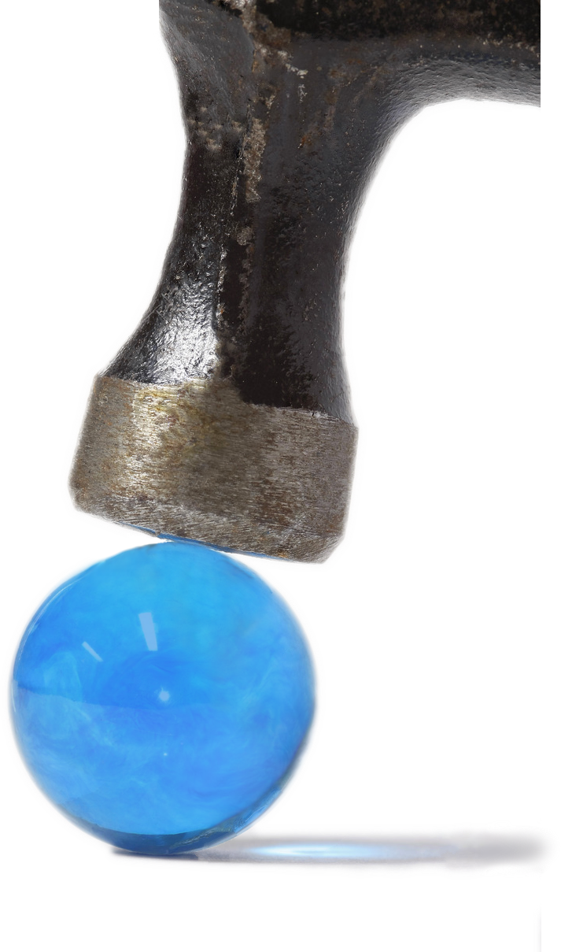
POWER BOUNCE
LOOK AT THESE
MARBLES
CAN THEY
STRETCH?
NO!

Slide 19
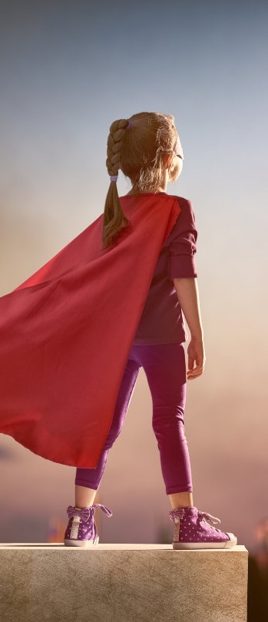
POWER BOUNCE
GROWTH vs FIXED MINDSET
GROWTH MINDSET
FIXED MINDSET

Slide 20














Growth or Fixed?
Growth or Fixed?
Growth or Fixed?
Growth or Fixed?
I didn't get the part I wanted in the school musical.
I must be a bad singer.
I don't try new things in case I make a mistake
If I don't get full marks in a test, it's because I'm not smart
If something doesn't work, I try PLAN B!
Growth or Fixed?
Growth or Fixed?
Growth or Fixed?
Growth or Fixed?
Growth or Fixed?
When I put in some effort, I get better at things!
Mistakes help me learn
If I’m not naturally good at something, it’s not worth trying.
The Spelling test was hard but I did my best
I didn’t make it into the top Netball team. I think I’ll quit netball.
Growth or Fixed ?
Growth or Fixed?
Growth or Fixed?
Growth or Fixed?
Growth or Fixed?
I want to be able to do a cartwheel. I'll practise every day until I can do it!
I want to join the cricket team but I don't know how to play cricket so I won't.
I forgot my friend's birthday. I must be a bad friend.
I want to join the netball team but I don't know how to play netball. I'll ask my friend to explain the rules.
I don't always win my tennis matches but I always do my best and put in lots of effort.

Slide 21

POWER BOUNCE
ACTIVITY
BOOKLET
EXERCISE 1

Slide 22


POWER BOUNCE
ACTIVITY
BOOKLET
Write 3 things you are good at in the stars
How did you get to be good at these things?
EXERCISE 2

Slide 23

POWER BOUNCE
ACTIVITY
BOOKLET
EXERCISE 3

Slide 24
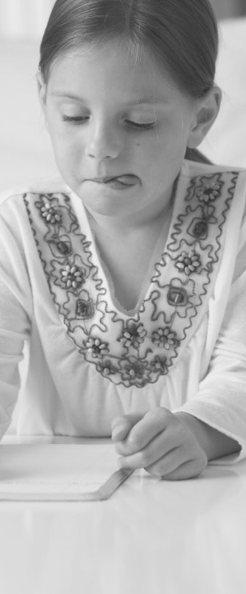
POWER BOUNCE
ONCE UPON A TIME
Once upon a time, there was a young girl called Joanne who lived in England.
In her spare time, Joanne loved to write stories about imaginary fantasy characters.
She would tell her stories to her younger sister.

Slide 25
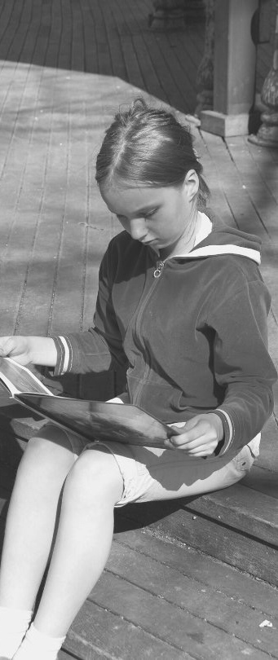
POWER BOUNCE
ONCE UPON A TIME
Joanne had a difficult childhood, but she loved to forget her troubles by reading books and writing stories.

Slide 26
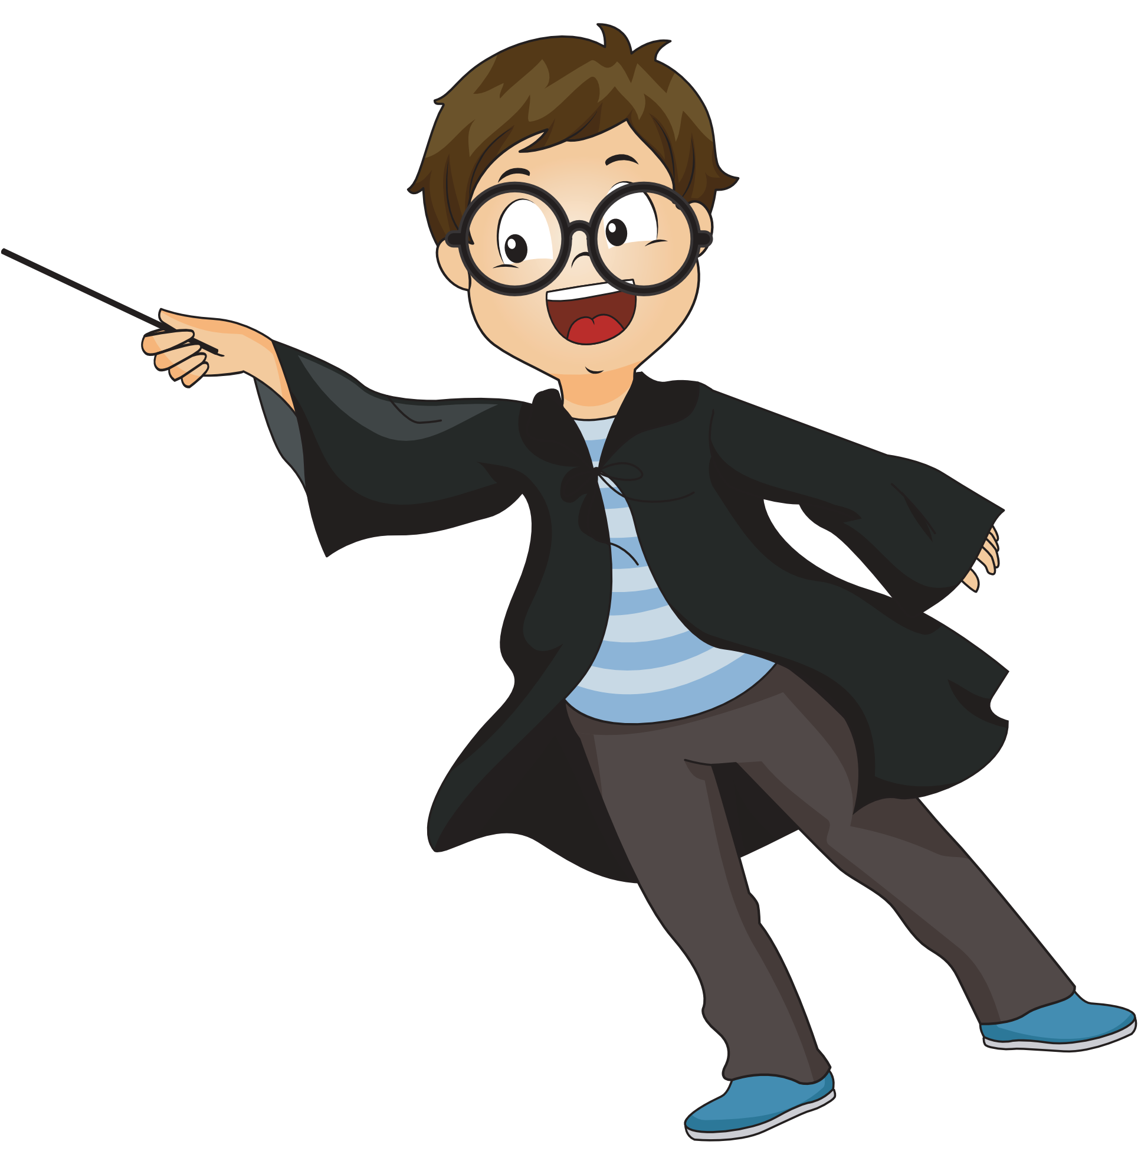

POWER BOUNCE
ONCE UPON A TIME
When Joanne grew up, she worked in various jobs but what she really enjoyed doing was writing stories.
She started writing a story about a boy who was a wizard and went to wizard school.

Slide 27
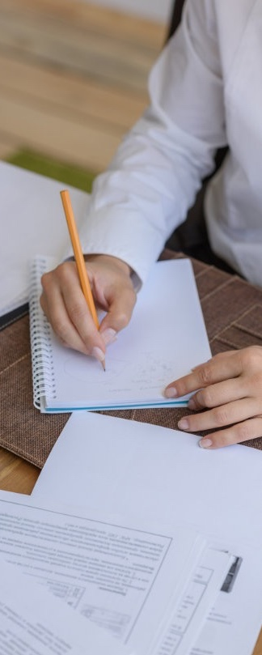

POWER BOUNCE
ONCE UPON A TIME
The wizard in her book was called Harry Potter.
It took Joanne years to write the book about Harry Potter - in fact, she wrote lots of books about him.

Slide 28
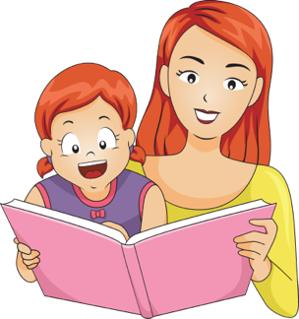
POWER BOUNCE
ONCE UPON A TIME
Joanne would read her stories to her daughter, Jessica.
Jessica loved the stories about Harry Potter and his adventures at wizard school.

Slide 29


POWER BOUNCE
ONCE UPON A TIME
One day, Joanne decided that she would try to get her books published so that other children could enjoy her stories.
She changed her name to J.K. Rowling.
She sent her books to a publisher.

Slide 30


POWER BOUNCE
ONCE UPON A TIME
But the publisher wrote back to J.K. Rowling and said....

Slide 31
POWER BOUNCE
ONCE UPON A TIME
So J.K. Rowling sent her books to another publisher....

Slide 32


POWER BOUNCE
ONCE UPON A TIME
But they also said....

Slide 33



POWER BOUNCE
ONCE UPON A TIME
J.K. Rowling could have given up, but she kept sending her books to different publishers.
In total, she sent her books to 13 publishers!

Slide 34

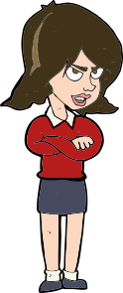


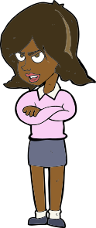
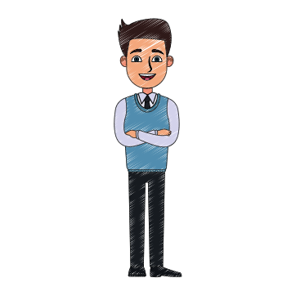



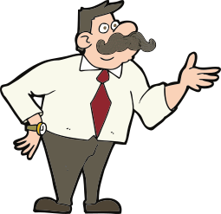

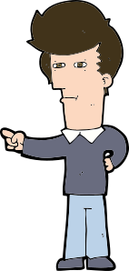
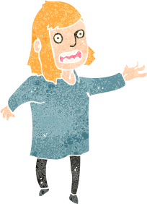

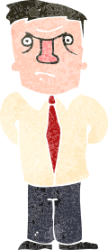
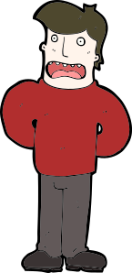

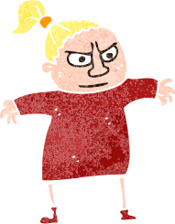

POWER BOUNCE
ONCE UPON A TIME
12 of them said …

Slide 35


POWER BOUNCE
ONCE UPON A TIME
But the 13th publisher said …

Slide 36
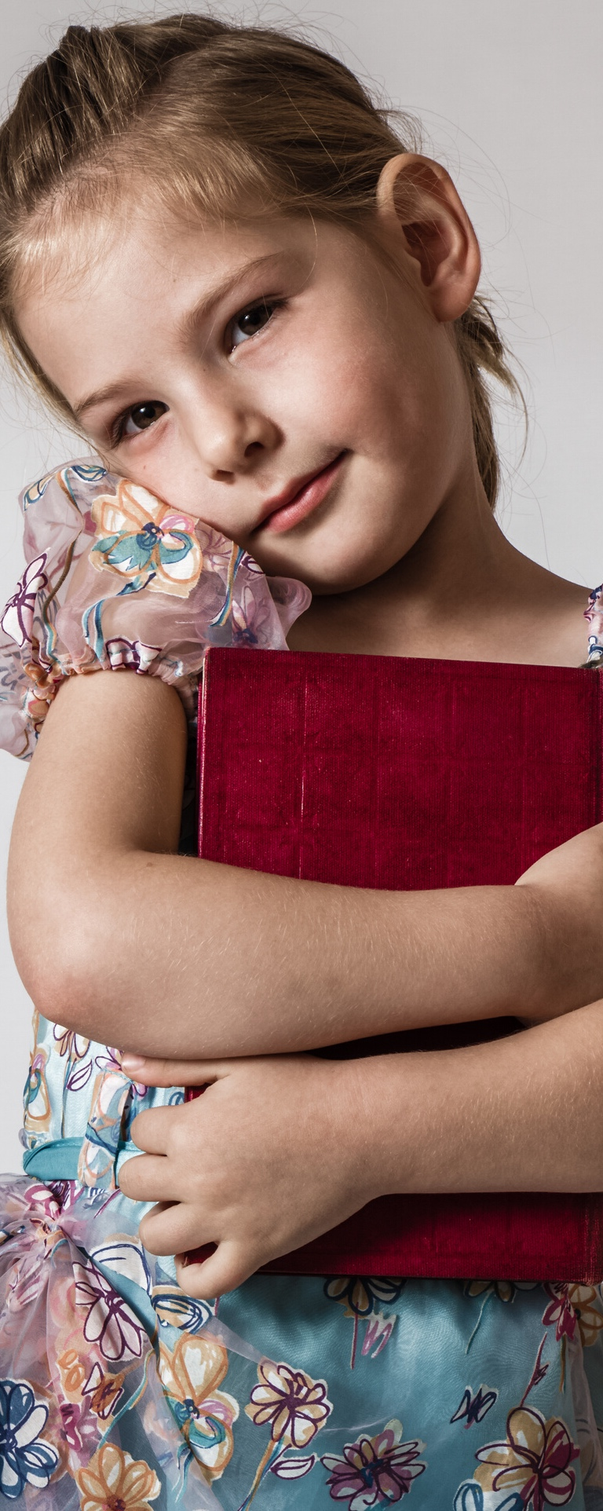
POWER BOUNCE
ONCE UPON A TIME
The Harry Potter books were published, and everyone loved them!

Slide 37

POWER BOUNCE
ONCE UPON A TIME
The stories were so popular that they were made into films.
J.K Rowling is now one of the most successful writers of all time.

Slide 38
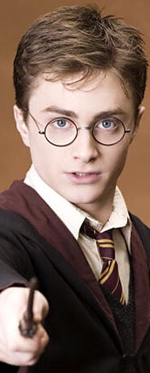
POWER BOUNCE
DISCUSS:
WHAT DID J.K. ROWLING NEED TO KEEP GOING?

Slide 39
POWER BOUNCE
WHAT DID J.K. ROWLING NEED TO KEEP GOING?
Persistence
Positive Mindset
Determination
RESILIENCE

Slide 40



POWER BOUNCE
WHAT POSITIVE STATEMENTS WOULD J.K. ROWLING HAVE SAID TO HERSELF?

Slide 41
POWER BOUNCE
WHAT POSITIVE STATEMENTS WOULD J.K. ROWLING HAVE SAID TO HERSELF?
I can do it
I won’t give up
I’ll keep trying

Slide 42
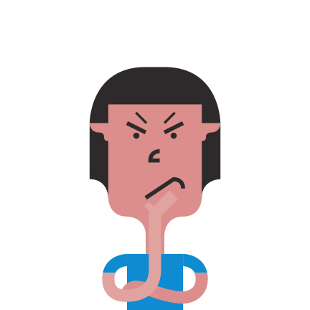
POWER BOUNCE
WHAT WOULD SOMEONE WITHOUT RESILIENCE SAY TO THEMSELVES?

Slide 43
POWER BOUNCE
WHAT WOULD SOMEONE WITHOUT RESILIENCE SAY TO THEMSELVES?
I give up
I’m hopeless
This is too hard

Slide 44
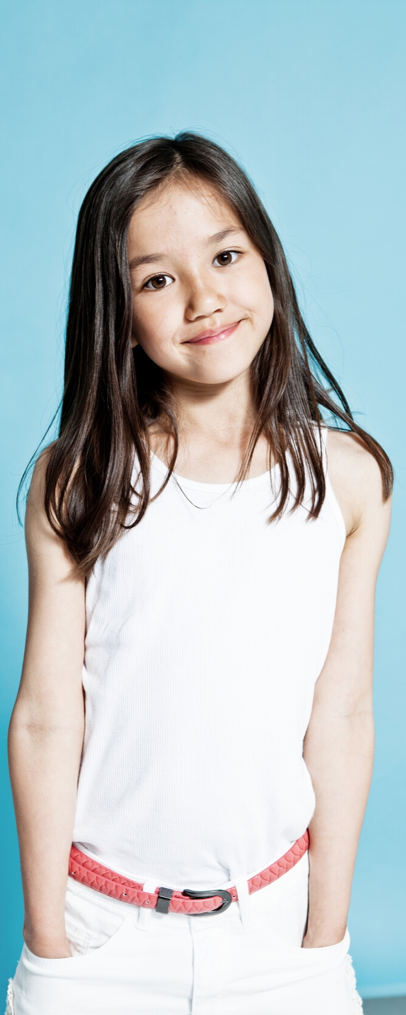
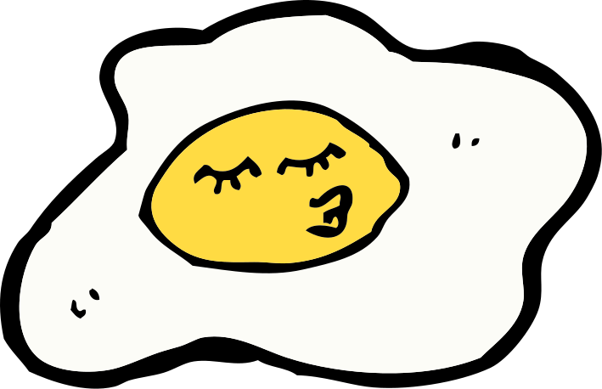
POWER BOUNCE
J.K. ROWLING HAD RESILIENCE!
When we have problems, or things don't go our way, we can choose to BOUNCE or SPLAT!

Slide 45


POWER BOUNCE
BOUNCE
BOUNCING BACK is not letting a problem get you down and upset for a long time - it means bouncing back to your awesome self!

Slide 46


POWER BOUNCE
SPLAT
Going SPLAT is getting stuck in your problem and your feelings.

Slide 47

POWER BOUNCE
BOUNCE
GAME:
OR
SPLAT

Slide 48
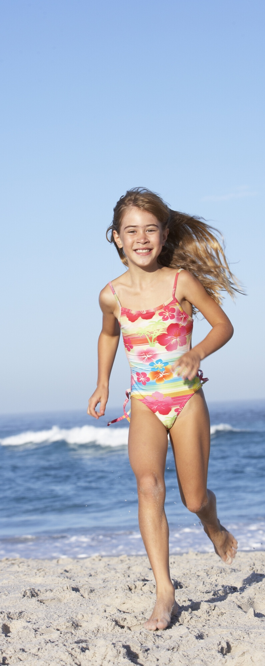

POWER BOUNCE
BOUNCE OR SPLAT
Wendy was building a sandcastle at the beach. It was amazing! Suddenly, a wave came out of nowhere and washed it away.
Wendy was mad! She started yelling and said that her whole day was ruined. She didn't talk to anyone for the rest of the day.
Did Wendy BOUNCE or SPLAT?

Slide 49
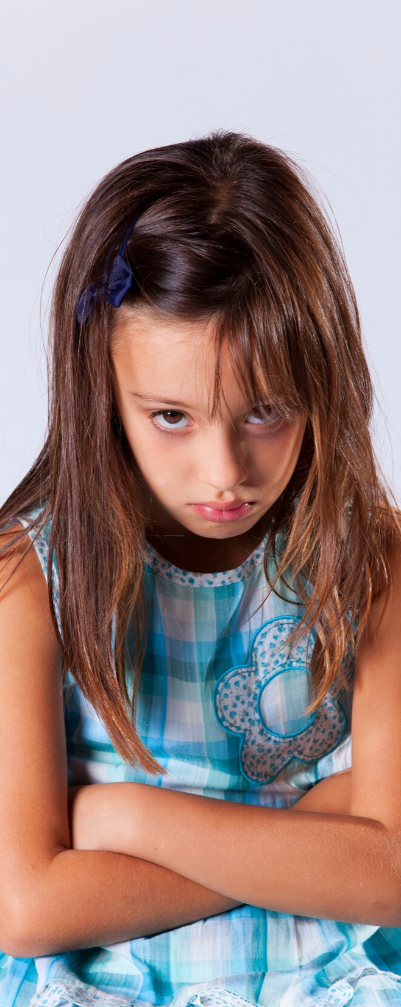
POWER BOUNCE
SPLAT!

Slide 50

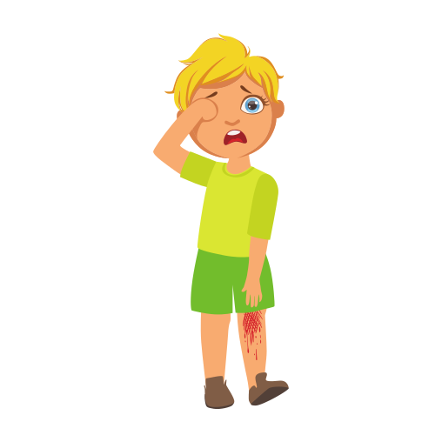
POWER BOUNCE
BOUNCE OR SPLAT
Nicole fell over at lunchtime and hurt her knee. It hurt!
She told a teacher about it who gave her a band-aid. Nicole told herself that she would be ok.
Did Nicole BOUNCE or SPLAT?

Slide 51
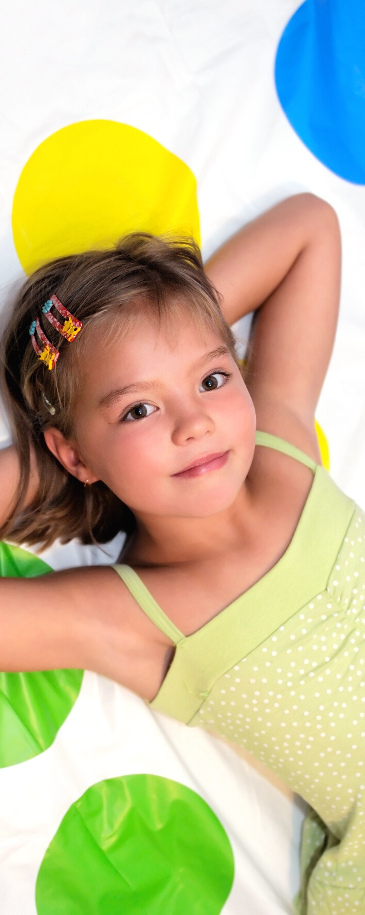
POWER BOUNCE
BOUNCE

Slide 52
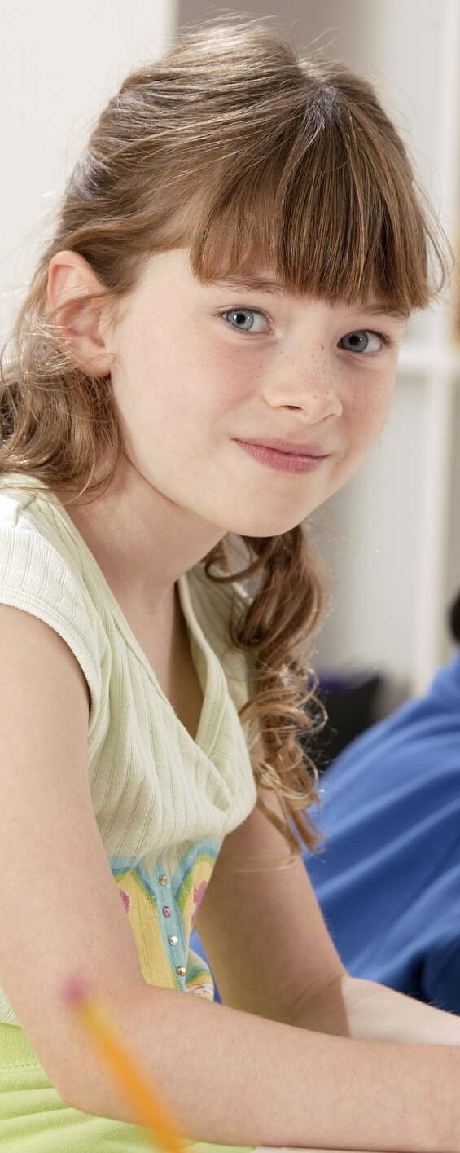
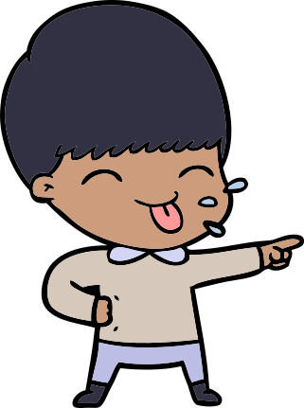
POWER BOUNCE
BOUNCE OR SPLAT
A boy in Grace's class poked his tongue out at her in a mean way.
Grace took some deep breaths and got on with her work.
Did Grace BOUNCE or SPLAT?

Slide 53

POWER BOUNCE
BOUNCE

Slide 54

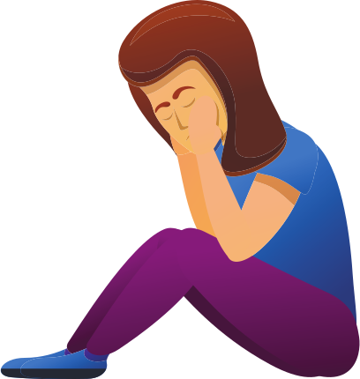
POWER BOUNCE
BOUNCE OR SPLAT
The teacher gave the class a really tricky Spelling test. Madison found it hard and said: “I'll never be able to do this”.
She put her head down and gave up.
Did Madison BOUNCE or SPLAT?

Slide 55

POWER BOUNCE
SPLAT!

Slide 56

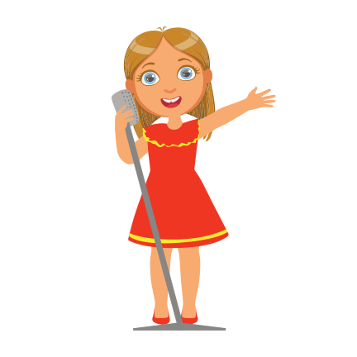
POWER BOUNCE
BOUNCE OR SPLAT
Amelia was performing in the school play. She forgot one of her lines.
Afterwards, she talked to her mum about it and reminded herself that she did her best and that it wasn't a big deal.
Did Amelia BOUNCE or SPLAT?

Slide 57

POWER BOUNCE
BOUNCE

Slide 58
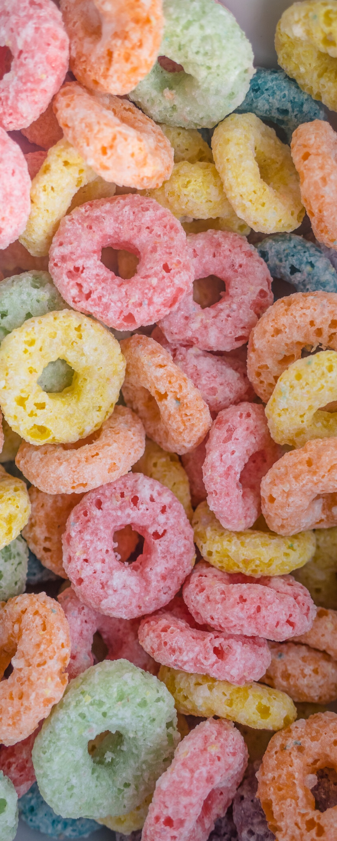
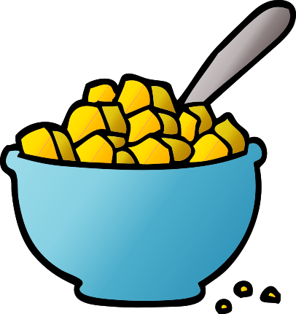
POWER BOUNCE
BOUNCE OR SPLAT
Kate didn't get to eat the cereal she wanted for breakfast.
She yelled at her mum and told her that she was mean.
Kate was very grumpy all morning.
Did Kate BOUNCE or SPLAT?

Slide 59
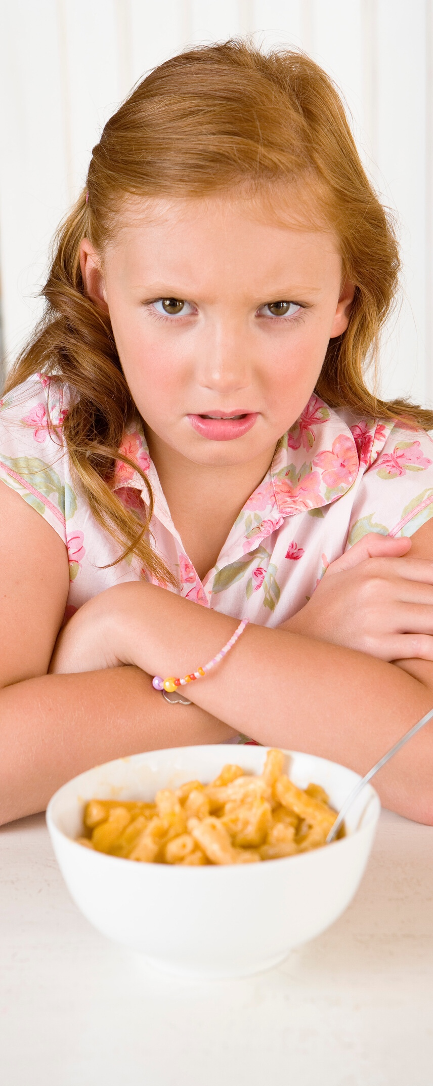
POWER BOUNCE
SPLAT!

Slide 60
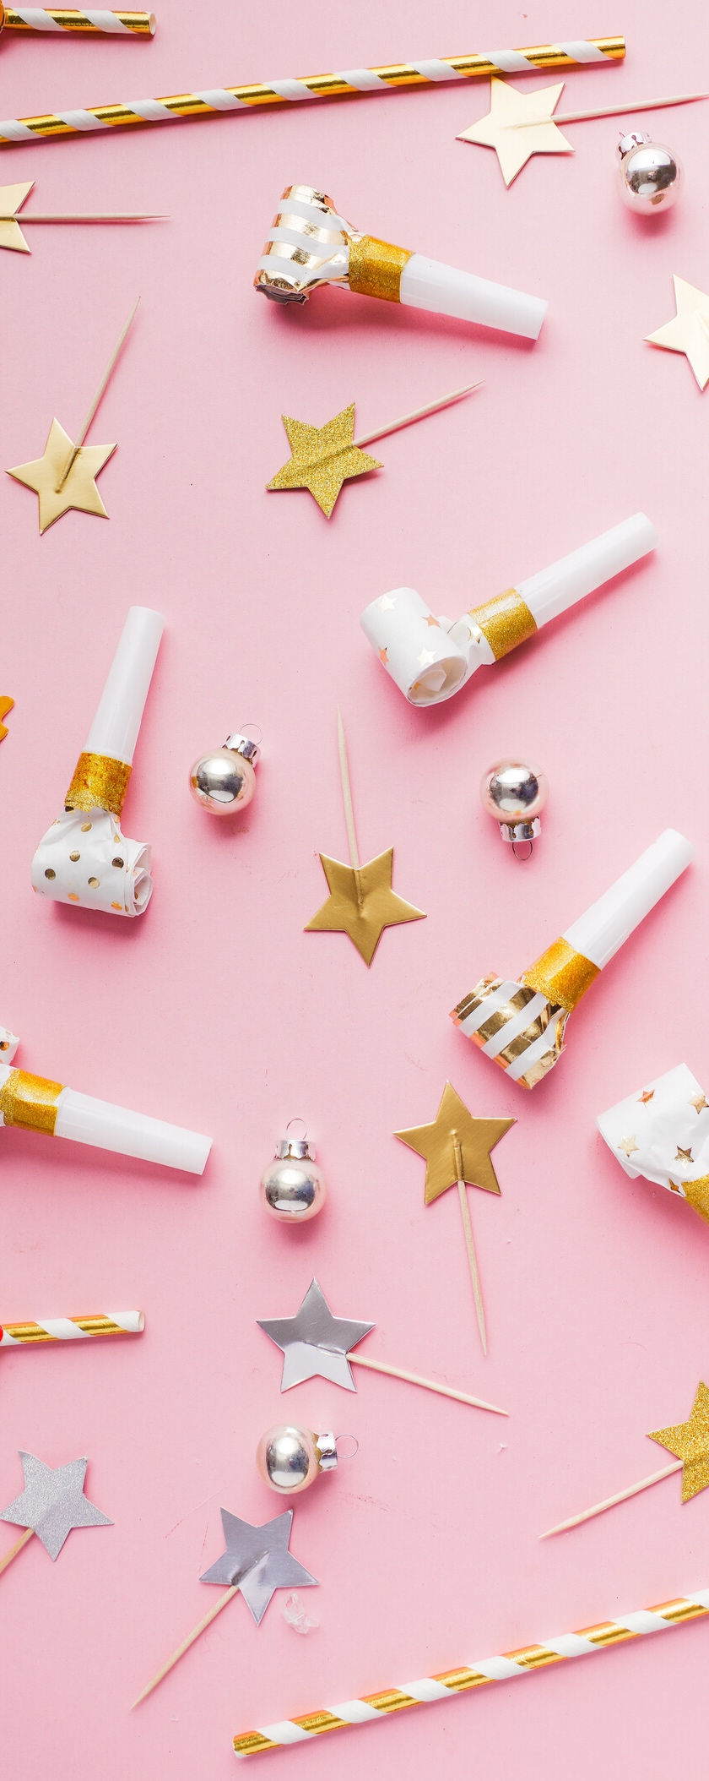
POWER BOUNCE
BOUNCE OR SPLAT
Ellie didn't get invited to a birthday party.
She was disappointed but decided to invite her cousin over for a play.
Did Ellie BOUNCE or SPLAT?

Slide 61
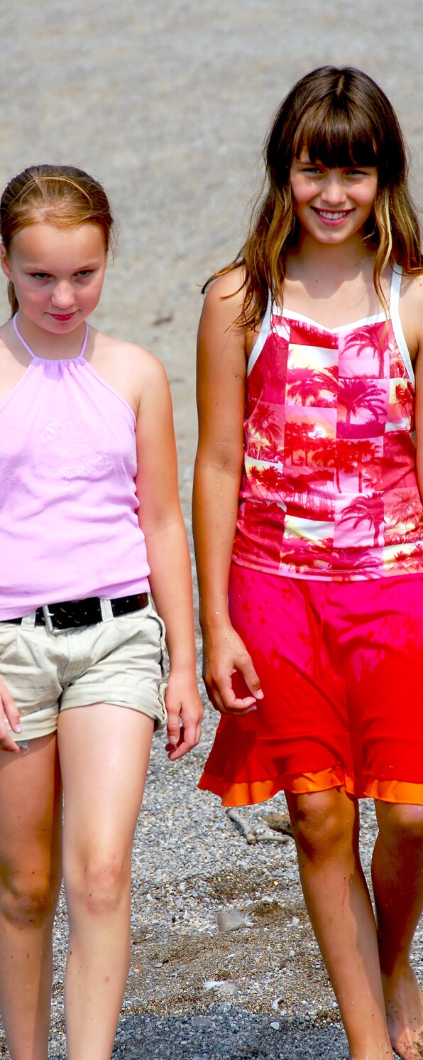
POWER BOUNCE
BOUNCE

Slide 62




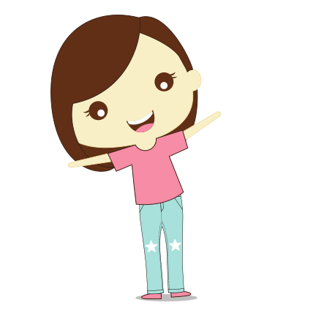
POWER BOUNCE
BOUNCE OR SPLAT
When you have problem, you get to choose how to respond!
BOUNCE or SPLAT?

Slide 63

POWER BOUNCE
BOUNCE OR SPLAT
Can you think of any times when you have BOUNCED BACK from a problem?

Slide 64
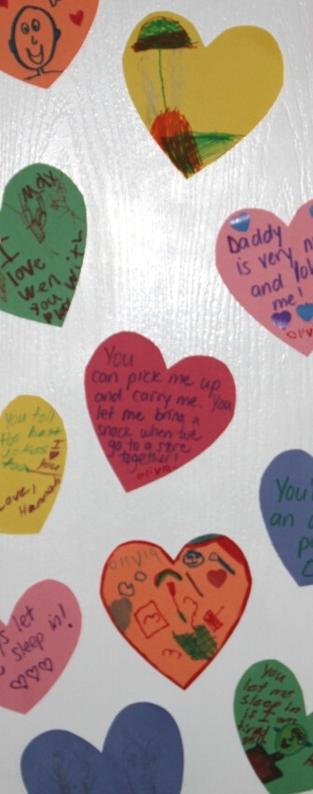



POWER BOUNCE
SOMETHING TO DO AT HOME …
KINDNESS HEARTS!
You'll need...
Paper
Scissors
Textas

Slide 65

POWER BOUNCE
IN TODAYS’ WORKSHOP …
I ENJOYED ... ?
I LEARNED THAT ... ?

Slide 66



ONLINE WORKSHOP
POWER BOUNCE
THANK YOU
FOR COMING
WE HOPE
YOU HAD FUN!

