Slide 1

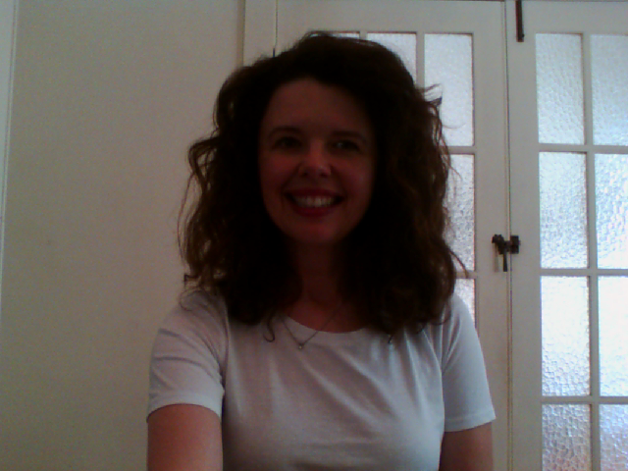
The Power of
Positive Emotions 1

Slide 2
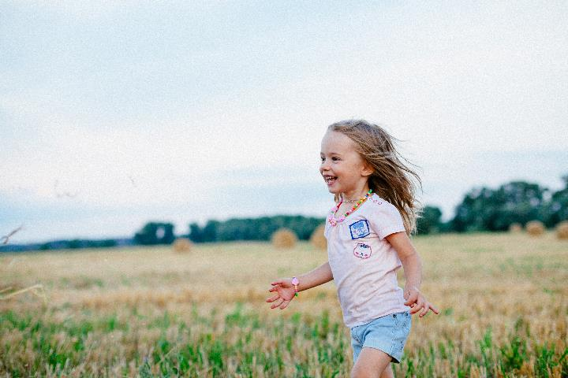

What are Positive Emotions?
Positive emotions provoke feelings where there is a lack of negativity
Often no pain or discomfort is felt
Barbara Frederickson (2009) says there are 10 most common positive emotions
They usually lead to a happy and vital life
Even fleeting moments have a beneficial impact
Often provoked by some sort of action ie. creative endeavours, wellness activities (yoga, Pilates, meditation).

Slide 3
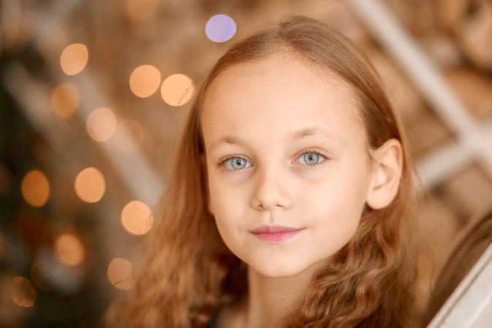
Why are Positive Emotions Important?
Positive emotions contribute to higher levels of well-being
Our immune system is strengthened
People with higher levels of well-being are overall healthier, live longer, are more resilient and successful
They see themselves as more fortunate, as ‘lucky’
Difficult situations are easier to manage
Our problem solving skills are strengthened
They increase our awareness, attention and memory.

Slide 4
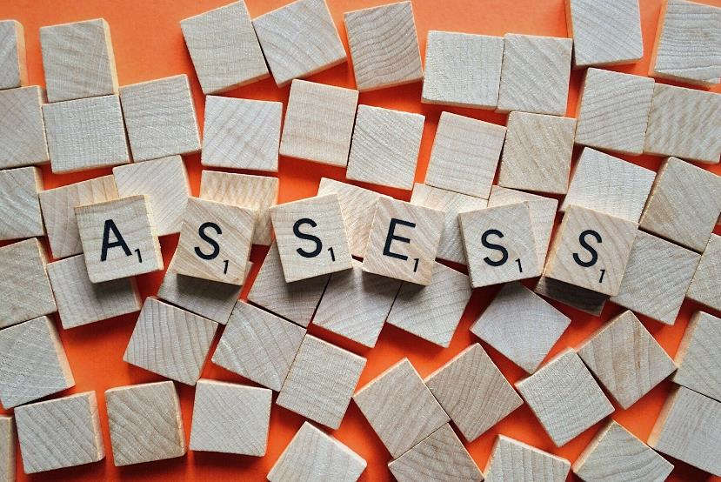
How to Assess Well-being
‘Work on Well-being’ assessment
The assessment highlights areas of low well-being
Well-being development solutions
A general assessment, including career
Well-being is changeable and fluctuates depending on levels of positive emotions
There are several scales, assessments and tools available across many areas of positive psychology (this is the one we recommend as it is broadly used, quick and free).

Slide 5
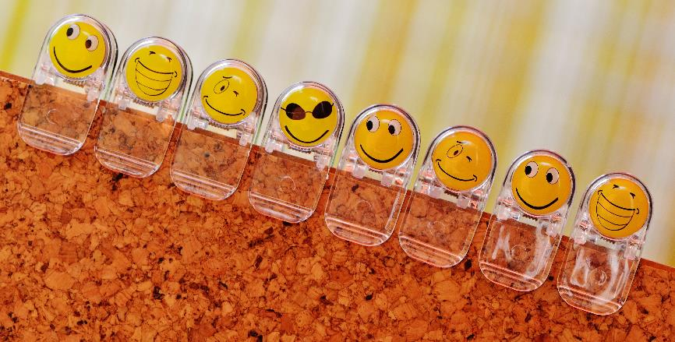
How to Increase
Positive Emotions
Complete a well-being assessment such as ‘Work on Well-being’ to highlight areas of development
List all those activities that make you feel good (walk in nature, yoga, meeting new people)
List the people you feel good being around
PERMA (Martin Seligman)
What are you grateful for?
Implement an exercise program into your life
Listen to uplifting music
What engaging activities are part of your life, in work and personally?
Do you have vision, purpose and meaning in your life?
Strengthening your relationships and developing new ones

Slide 6
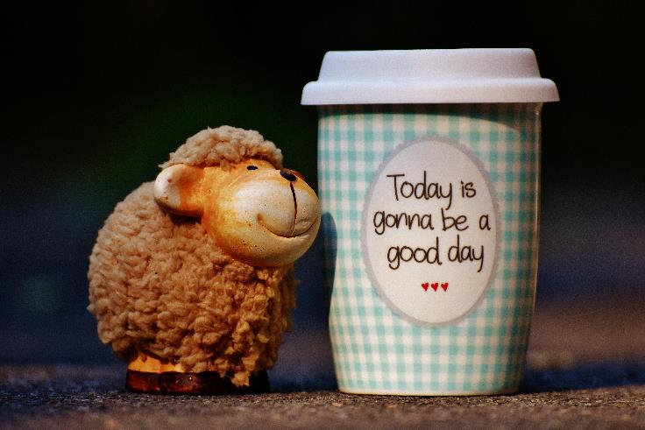
How we Teach Girls to Increase
Well-being and Positive Emotions
PERMA model taught to girls for life application
P – positive emotions – role playing, friendship activities, dancing, creating and connecting with new friends, identifying individual strengths (gratitude jars, positivity rocks, strengths chains)
E – many different fun and creative activities that have girls fully engaged
R – making new connections, role playing and workshop chats/workbooks about positive friendships
M – activities that spark vision and goal setting
A – the workshop itself is an achievement as many girls are nervous to be there.

Slide 7
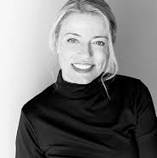
Girl Power Workshops
Thank you for listening to our Positive Emotions 1 training
Our Girl Power tribe is growing and together our vision to educate as many girls as possible, in the areas of empowerment and self-esteem, is becoming a reality
Joni Combe, Director at Girl Power Workshops Australia.
www.girlpowerworkshops.com.au
“Happiness does not depend on what happens outside of you, but what happens inside of you”.

