Slide 1


Positive Psychology
What is it?

Slide 2
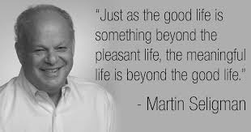
What is Positive Psychology?
Positive Psychology is a term created by Martin Seligman, known as the ‘father of Positive Psychology’
Zones in on what is right with an individual, versus the more traditional psychology model of focussing on what is wrong
Encourages all emotions and implements positive and enjoyable activities unique to the individual, supported by a more positive way of viewing life
Is a scientific study about what makes life worth living, shining light on aspects of well-being, personal strengths and the benefits of flow, creativity, community, physical and psychological health
The study of strengths in individuals and communities
Establishes meaning and purpose in life
Building resilience in people, with the goal of bouncing back following a challenge or adversity.

Slide 3
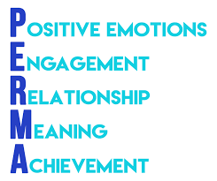
PERMA
Seligman’s PERMA™ theory highlights what brings happiness to an individual
Five building blocks – Positive Emotions, Engagement, Relationship, Meaning, and Accomplishment/Achievement
Each person discovers well-being from each of the five elements, to a lesser or greater degree
Positive Psychology provides informed choices on how to live a fulfilling life that resonates the individual’s values and interests.

Slide 4
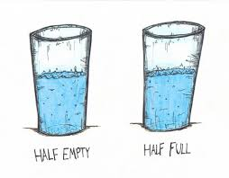
What is Learned Optimism?
Martin Seligman says it is a ‘tendency to expect the best possible outcome or dwell on the most hopeful aspects of a situation’
The ripple effects of optimism make people more resilient, live longer, have better physical health, more likeable and achieve more
Optimism or pessimism in how we speak to ourselves (our internal dialogue) - also known as our individual ‘explanatory style’
Seligman points to three ways of thinking in terms of optimism/pessimism and calls this our ‘explanatory style’.
- Permanence - Pervasiveness – Personalisation -

Slide 5
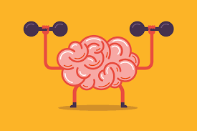
Why is Knowing Strengths Important?
Strengths analysing is vital to know more about ourselves and others
Knowing who you are is key to a healthy and robust self-esteem
The VIA Character Strengths survey provides a profile of 24-character strengths
When we live life based on signature strengths, we have more energy for the activities we are doing and enjoy our life more
Strengths can be honed, developed and worked on.

Slide 6
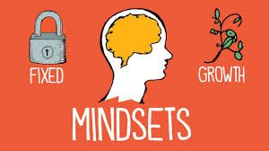
The Importance of a Growth Mindset
Children with a growth mindset understand their abilities and skills can improve through effort, hard work and persistence
I cannot do this yet – the power of yet!
A growth mindset can be taught
Children with a fixed mindset believe their abilities are a fixed set of traits they are born with
A growth mindset is linked to success.

Slide 7
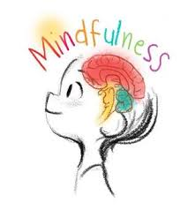
Mindfulness
Ellen Langer has been researching mindfulness in positive psychology for 35 years and interested in the impact it has on our well-being
There is a lot of research about its positive benefits when integrated into education
Many of the techniques are derived from Buddhist traditions due to thousands of years of research
We can meditate and/or train our mind to reach a mindful state.

Slide 8
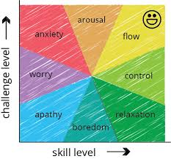
Flow Theory
‘Flow is an optimal psychological state that people experience when engaged in an activity, that is both appropriately challenging to one’s skill level, often resulting in immersion and concentrated focus on a task. This can result in deep learning and high levels of personal and work satisfaction’, Mihaly Csikszentmihalyi
When someone is completely engrossed in an activity and hours pass without them noticing - they are ‘in the zone’, almost in a hypnotic trance
Art, dance, sport, creating something.

Slide 9
Researchers
Martin Seligman ‘learned optimism and character strengths’
Carol Dweck ‘growth Mindset’
Ellen Langer ‘mindfulness’
Mihaly Csikszentmihalyi (pronounced ‘cheek sent me hi’) ‘flow theory’
For a detailed list of researchers visit www.positivepsychologyprogram.com

Slide 10
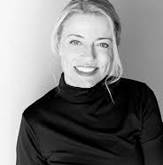
Girl Power Workshops
Thank you for listening to our presentation
We are excited to work together, in empowering the women of tomorrow
Joni Combe, Director at Girl Power Workshops Australia.
www.girlpowerworkshops.com.au

