Slide 1
ONLINE WORKSHOP
FREE TO BE ME
WELCOME!

Slide 2
ONLINE WORKSHOP
FREE TO BE ME
INTRODUCE YOURSELF!

Slide 3
ONLINE WORKSHOP
FREE TO BE ME
HAVE YOU
EVER … ?!

Slide 4
FREE TO BE ME
-
BRAINSTORM:
HOW ARE WE ALL DIFFERENT?

Slide 5
FREE TO BE ME
HOW ARE WE ALL DIFFERENT?
Personality
Interests
Likes/Dislikes
The way we look
Culture
Family
Attitudes
Values
Abilities

Slide 6
FREE TO BE ME
FREE TO
BE ME
BOOKLET

Slide 7
FREE TO BE ME
DISCUSS:
WHAT ARE OUR STRENGTHS?

Slide 8
FREE TO BE ME
WHAT ARE OUR STRENGTHS?
Sports (eg soccer, netball, swimming)
Creative (eg dance, music, drama, art, making videos)
Language (eg writing stories, speaking other languages, reading, acting with scripts
Logic (eg puzzles, fixing things, Maths, puzzles, computer games)
Character (eg kindness, organised, determined, generous, reliable, friendly, thoughtful, funny)

Slide 9
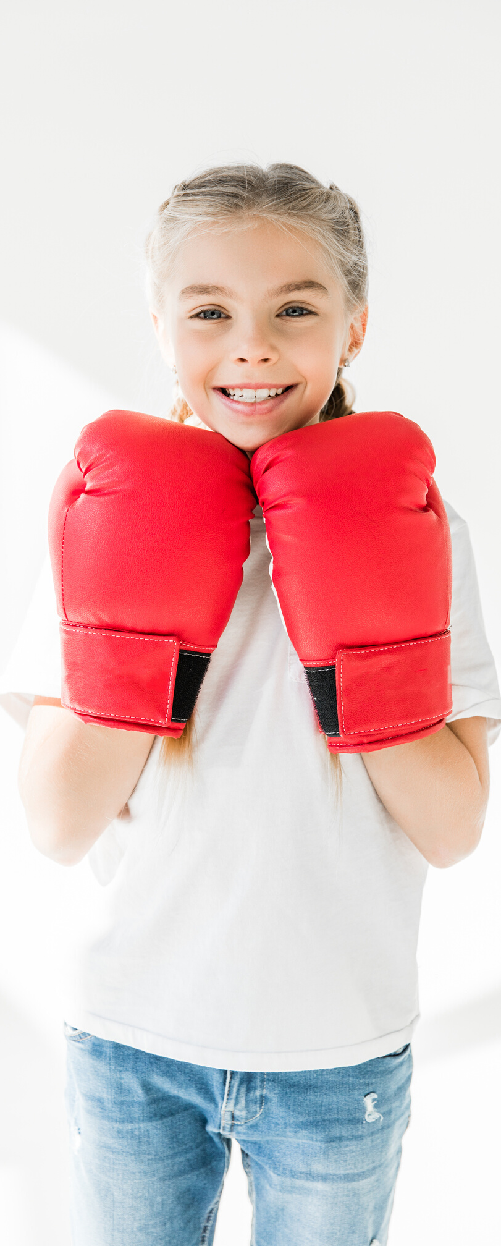
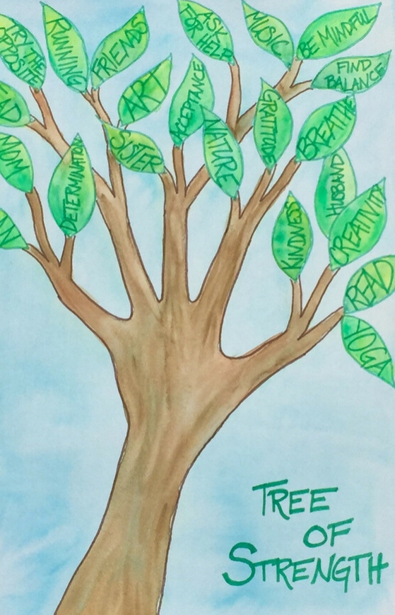
FREE TO BE ME
STRENGTHS
TREE

Slide 10
FREE TO BE ME
GAME:
WHAT IF ?

Slide 11
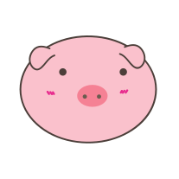
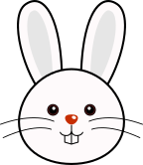
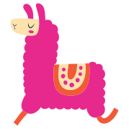
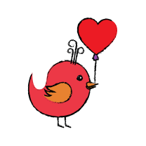
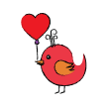
What if?
What if?
What if?
What if?
What if?
You said something nice to yourself? What would it be?
You felt upset or sad - who would you talk to?
Someone told you one of your strengths was dumb or silly?
Someone told you that you should change to be like everyone else?
A friend asked you to do something you didn't feel comfortable with?
What if?
What if?
What if?
What if?
What if?
I asked you what is something that always make you feel happy?
You were given an award for a character strength - what would it be?
You could change something about the world - what would it be?
You could do anything as a job when you are an adult??
Your wish came true - what would happen?
What if?
What if?
What if?
What if?
What if?
If you could invent something to help people, what would it be?
You wrote a book about your life - what would it be called?
I asked you what is one thing you feel grateful for today?
I asked you, who is someone in your life who always makes you smile?
You could change something about school - what would you change?

Slide 12
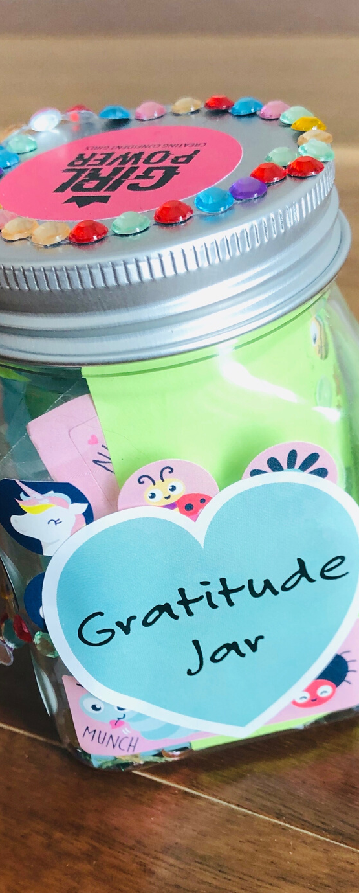
FREE TO BE ME
SOMETHING TO DO AT HOME …
MAKE A GRATITUDE JAR!
You'll need...
A clean empty jar
A blank piece
of paper
Scissors
Pens
Stickers

Slide 13
FREE TO BE ME
IN TODAYS’ WORKSHOP …
I ENJOYED ... ?
I LEARNED THAT ... ?

Slide 14
ONLINE WORKSHOP
FREE TO BE ME
THANK YOU
FOR COMING
WE HOPE
YOU HAD FUN!

